Slide 1
NE 763: Advanced Reactor Materials
Fall 2025
Dr. Benjamin Beeler

Slide 2
Last Time
Different defect regimes
Different swelling regimes
Thermal conductivity degradation

Slide 3
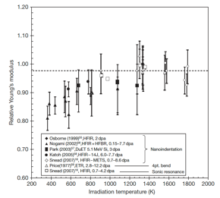
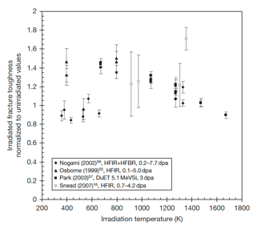
SiC Mechanical Properties
Irradiation generally reduces modulus to a greater extent for lower temperature irradiation, while the modulus reduction becomes negligible when irradiation temperature reaches or exceeds 1273 K
Irradiation-induced toughening (increase in fracture toughness) seems to be significant at 573–1273K in spite of the decrease in elastic modulus
However, there is significant scatter in the data
Reminder: toughness is related to the area under the stress–strain curve

Slide 4
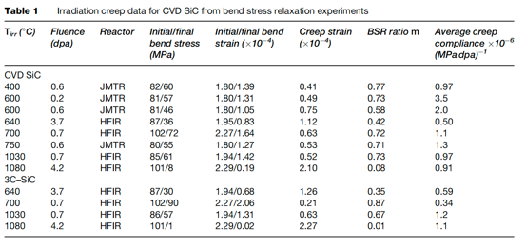
SiC Creep
Irradiation creep is defined as the difference in dimensional changes between a stressed and an unstressed sample irradiated under identical conditions
Studies on irradiation creep of SiC have been limited, although it is of high importance for SiC in TRISO particles
The creep strain for CVD SiC exhibited a weak temperature dependence at <0.7 dpa whereas a major transition at higher doses likely exists at higher temperatures

Slide 5
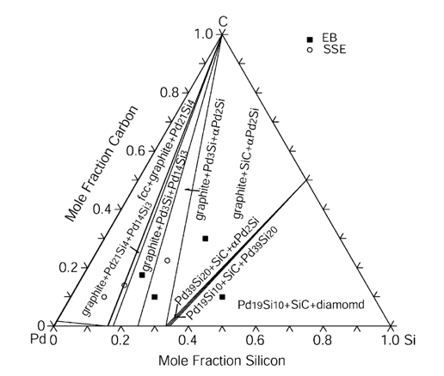
SiC Corrosion
The silicon carbide layer serves as a critical fission product barrier, but can be corroded by fission products, in particular palladium
Additionally, silver can be transported through intact SiC layers
For Pd, the reaction with SiC can be qualitatively explained by the phase-diagram, where a number of intermetallic structures are present
To prevent corrosion by Pd, new combinations of coating layers have been proposed, and means of trapping Pd in the fuel are explored

Slide 6
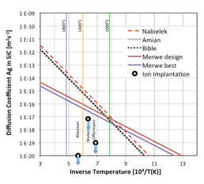
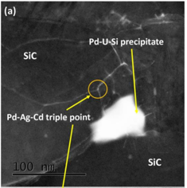
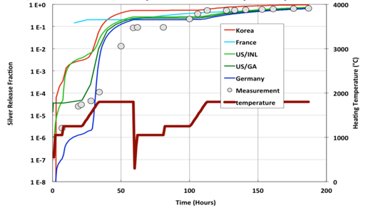
SiC Corrosion
Silver release has been observed from undamaged particles suggesting that Ag migrates through intact SiC layers at temperatures >1100 C
The Ag migration mechanism remains not fully understood, but has a temperature dependence, and is expected to be grain boundary diffusion driven
From microstructural analyses, it seems possible that Ag, Cd, and Pd cluster and transport together at grain boundaries and triple points because of their common chemical properties

Slide 7
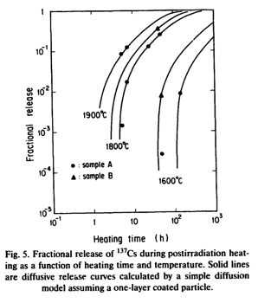
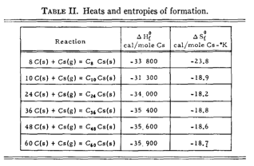
SiC Corrosion
Once cesium has migrated into the buffer, it can react with carbon
At nominal temperatures, cesium may be released from the fuel and associate with carbon of the buffer layer to form compounds
These compounds can vaporize, and may become a potential source of cesium release
Typically, cesium-graphite compounds are not stable at 923 K under vacuum and decompose to give cesium vapor and graphite

Slide 8
Wrap-Up on SiC
SiC: high strength, high thermal conductivity, high temperature stability, oxidation resistant
Radiation damage is dependent on temperature/fluence
Radiation induced swelling corresponds to defect types
In point defect swelling regime, thermal conductivity directly corresponds to defect concentration
Mechanical properties largely unaffected by irradiation
Reasonably good creep resistance, more susceptible to irradiation creep at high T
Pd attack is a key concern, with Pd-Si compounds consuming the SiC layer
Ag release can occur in intact particles, probably via GB diffusion

Slide 9
Graphite

Slide 10
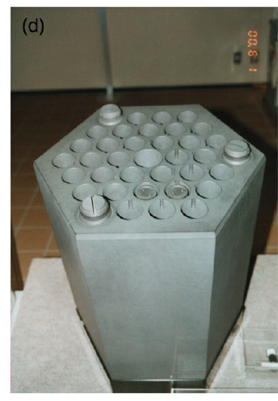
Graphite Usage
Graphite was the moderator in the first reactor to sustain a chain reaction and has been used as a moderator in over 100 nuclear reactors, many of which are still operating
Graphite has a high neutron scattering cross-section and a very low neutron absorption cross-section, making it an ideal moderator

Slide 11
Delineate Types of Graphite
TRISO Graphite (PyC)
CVD deposition
treated to ensure ultra dense and high purity
Prismatic Blocks and Pebbles
large scale
different fabrication process from TRISO
different microstructure
We will generally be talking about large scale graphite, which most directly applies to prismatic block type graphite
Similar radiation effects are assumed to occur in PyC layers
Not sufficient research into potential differences in PyC vs bulk graphite behavior

Slide 12
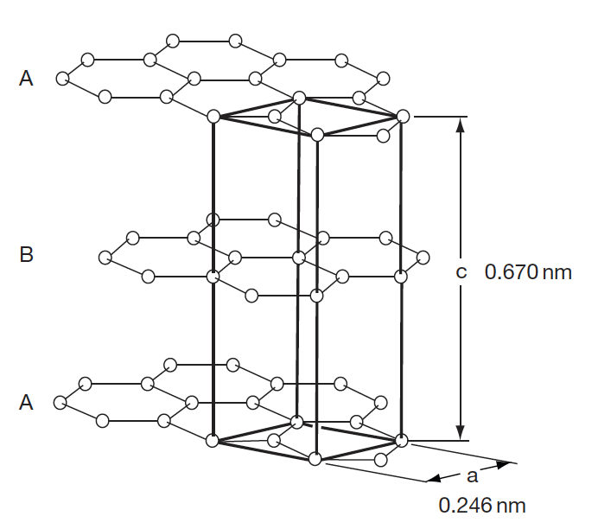
Graphite Structure
The electronic hybridization of carbon atoms (1s2, 2s2, 2p2) allows several types of covalent-bonded structures
In graphite, we have sp2 hybridization where the carbon atom is bound to three equidistant nearest neighbors in a given plane to form the hexagonal graphene structure
The sheets are weakly bound with van der Waals type bonds in an ABAB stacking sequence with a separation of 0.335 nm

Slide 13
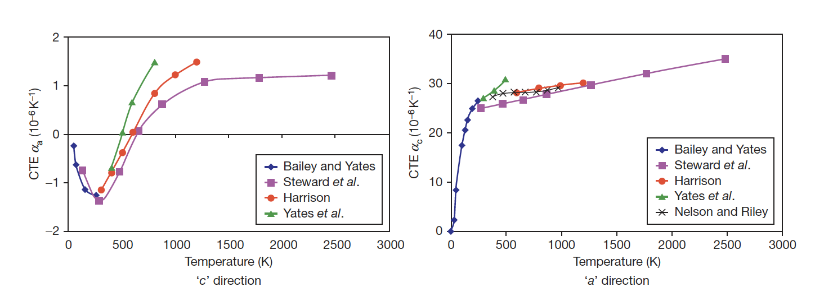
Fundamental Properties
The CTE for graphite displays anisotropic behavior, and strongly varies as a function of temperature
Due to the structure, the strength along the basal planes is higher than the strength perpendicular to the planes, and the shear strength between the basal panes is relatively weak
The thermal conductivity along the basal planes is much greater than perpendicular to the planes

Slide 14
Mrozowski Cracks
During the manufacture of artificial graphite, very high temperatures (2800–3000 C) are required
Upon cooling, the anisotropy in thermal expansion coefficients leads to the formation of long, thin microcracks parallel to the basal planes, often referred to as ‘Mrozowski’ cracks
The presence of these microcracks is very important in understanding the properties of nuclear graphite
These cracks form in both TRISO PyC, sometimes called highly orientated pyrolytic graphite (HOPG), and standard nuclear graphite

Slide 15
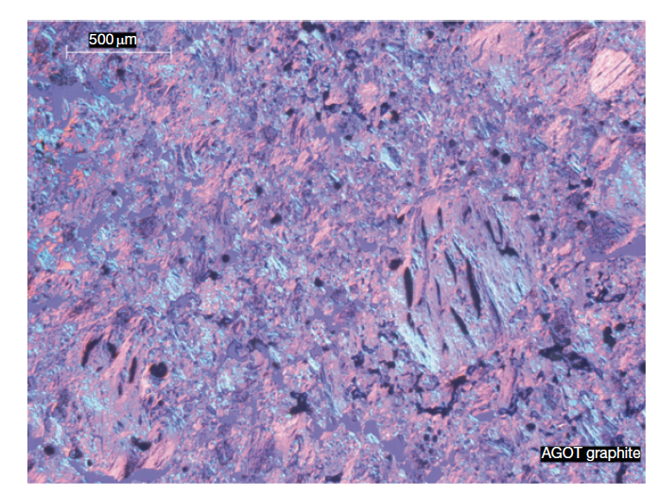
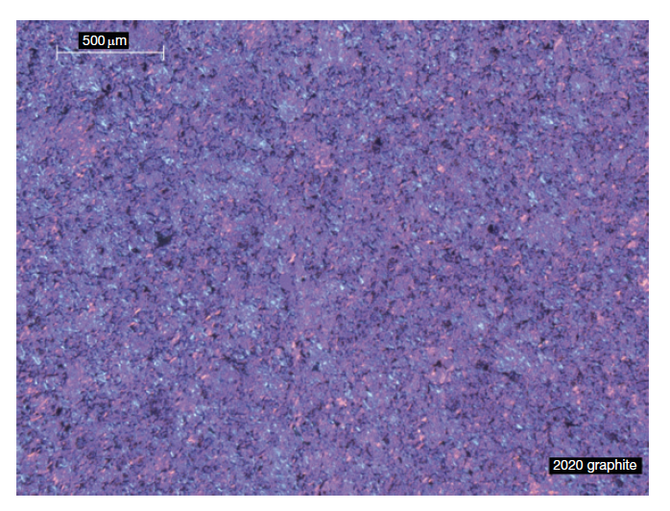
Graphite Texture
Graphite structure is largely dependent upon the manufacturing process
Graphites are classified according to their grain size from coarse-grained (containing grains in the starting mix that are generally >4mm) to microfine-grained (containing grains in the starting mix that are generally <2 μm)
Grade AGOT was used as the moderator in the earliest nuclear reactors in the United States
Nuclear graphite is medium to fine grained, includes grades of Gilsocarbon, IG-110 and IG-11, and many others
Ideally manufacture graphite with bulk isotropic properties; with grain/against grain ratios near 1

Slide 16
Initial Porosity
A dominant feature of graphite texture is the amount of porosity
About half the total porosity is open to the surface
The formation of pores and cracks in the graphite during manufacture adds to the texture arising from grain orientation and causes anisotropy in the graphite physical properties
Three origins of porosity:
Those formed by incomplete filling of voids
Gas entrapment during pyrolysis
Thermal cracks

Slide 17
RADIATION EFFECTS IN GRAPHITE

Slide 18


Graphite Shrinkage
When graphite components are irradiated in a reactor, significant changes to their dimensions and properties occur
The unit of irradiation exposure EDND used in the figures is particular to nuclear graphite technology
EDND = Equivalent DIDO Nickel Dose
EDNF = Equivalent DIDO Nickel Flux
They are based upon the equivalent nickel activation in the DIDO reactor

Slide 19
Graphite Shrinkage
Graphite typically shrinks with dose until a point is reached where the shrinkage stops, and the graphite starts to swell
This change from shrinkage to swelling is known as "turnaround”
Due to the manufacturing process of nuclear graphite, the graphite component has a much lower density than may be expected (1.7-1.9 g/cm3) compared with 2.2.6 g/cm3 for pure graphite crystals
The original state of the graphite, and the particular radiation defects in graphite, govern this fluence-dependent behavior

Slide 20
Graphite Dimensional Change
Dimensional change data obtained on AGR graphite samples are shown at the right
The higher the temperature the sooner ‘turnaround’ from shrinkage to swelling occurs
This behavior is typical for most semi-isotropic, medium and fine-grained graphite grades, although the magnitude of the changes varies from grade to grade
Nuclear graphite, such as Gilsocarbon, is semi-isotropic
Anisotropic graphite can display significantly different irradiation behavior

Slide 21
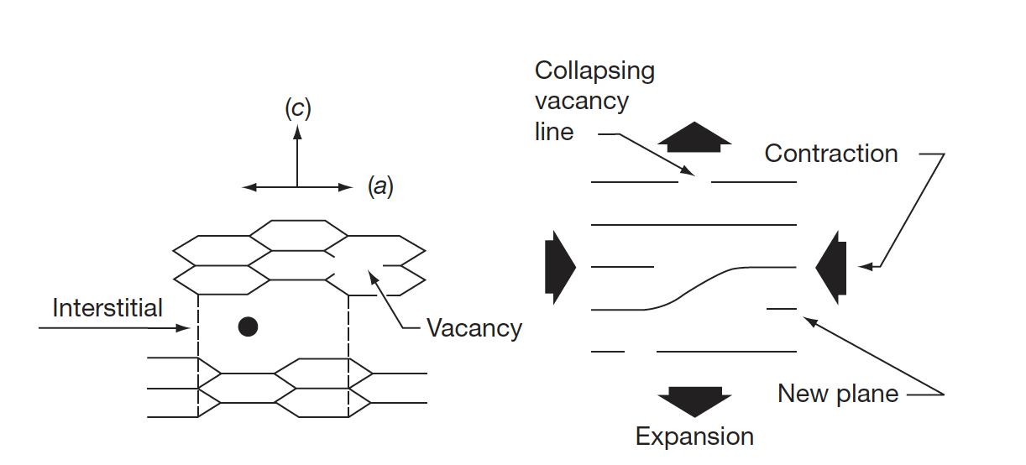
Interstitials in Graphite
The interstitial atom prefers to form a bridge-like structure on the graphene surface
Repelling the two graphene sheets increases c, yielding a corresponding contraction in a
Vacancies shrink the basal plane, further reducing a
Turnaround occurs when the matrix can no longer accommodate the defect-induced dimensional change

Slide 22
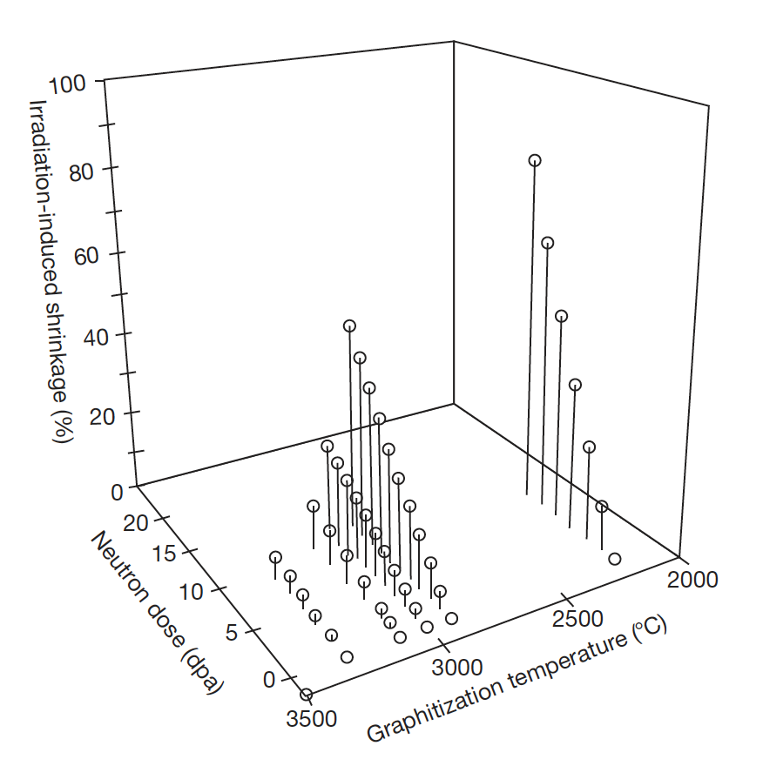
Graphite Shrinkage
Nuclear graphite possess a polycrystalline structure, usually with significant texture resulting from the method of forming during manufacture
Thermal shrinkage cracks that occur during manufacture and that are preferentially aligned in the crystallographic a-direction will initially accommodate the c-direction expansion
So, contraction in the a-direction will be observed, and graphite thus undergoes net volume shrinkage
With increasing dose, the crystallite dimensional changes fill in the porosity, and the volume shrinkage rate falls, eventually reaching zero
The graphite now begins to swell at an increasing rate with increasing neutron dose

Slide 23
Graphite Irradiation Under Loading
If graphite is irradiated under load the dimensional change data are modified
The difference between loaded and unloaded dimensional change is referred to as creep
The shrinkage is increased under compression and reduced under tension
With increasing fluence the creep strain increases fairly linearly at first, and then the rate reduces before finally increasing

Slide 24
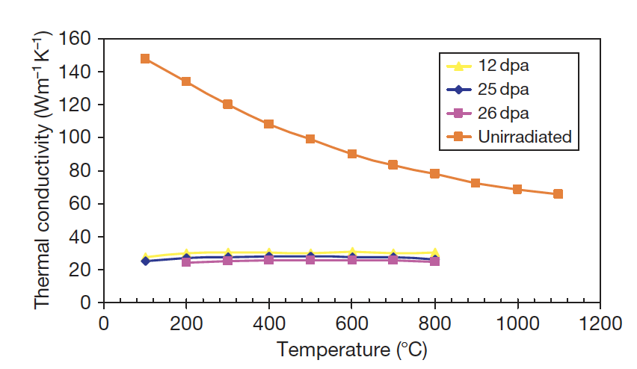
Thermal Conductivity
Graphite is a phonon conductor of heat
Similar to SiC, larger grain size, theoretical densities, low defect content, improve k
The increase of thermal resistivity due to irradiation damage has been ascribed to the formation of (1) small interstitial clusters, (2) vacancies, (3) vacancy loops
At any irradiation temperature, the decreasing thermal conductivity will reach a ‘saturation limit’

Slide 25
Impacts of Changes Under Irradiation
In graphite moderated reactors, the graphite structure provides channels for fuel, fuel-cooling, and control rod entry, the structural integrity of the graphite components is important from safety and lifetime considerations
Components develop stresses which need to be accounted for
Temperature distribution across a graphite channel is shown at the right
Fluence also changes radially
Fuel is in the center (bore)

Slide 26
Impacts of Changes Under Irradiation
Properties and dimensions change as a function of both temperature and fluence
First, the graphite brick will shrink faster at the bore than at the outside, and properties will vary radially
Graphite brick internal shrinkage and thermal stresses are generated; first tensile at the bore and compressive at the outside, and then reversing in sign towards the end of reactor life
Fortunately, much of this stress is reduced by irradiation creep

Slide 27
Impacts of Changes Under Irradiation
Discontinuities in the figure are due to shutdowns every 2 years
The difference in CTE between the inside and the outside of the brick, along with irradiation creep, causes the stresses to significantly change when the reactor is shutdown and the graphite cools
The change in stress at shutdown is mainly due to the temperature difference across the brick, which creeps out during reactor operation
Towards the EOL, this leads to significantly different stress states for the inside/outside of the graphite brick

Slide 28

Irradiation Creep
Graphite will undergo creep during neutron irradiation and under stress at temperatures where thermal creep is generally negligible
Creep is so fundamentally important to graphite that if irradiation-induced stresses in graphite moderators could not relax via radiation creep, rapid core disintegration would result
One study showed that a 50% decrease in the assumed creep strain resulted in a 50% increase in the predicted hoop stress in a hollow cylindrical core brick
The total strain, in a graphite component under irradiation in a reactor core is given by:
where ε_{e} is the elastic strain; ε_{t}, the thermal strain; ε_{d}, the dimensional change strain; and ε_{c} is the creep strain

Slide 29
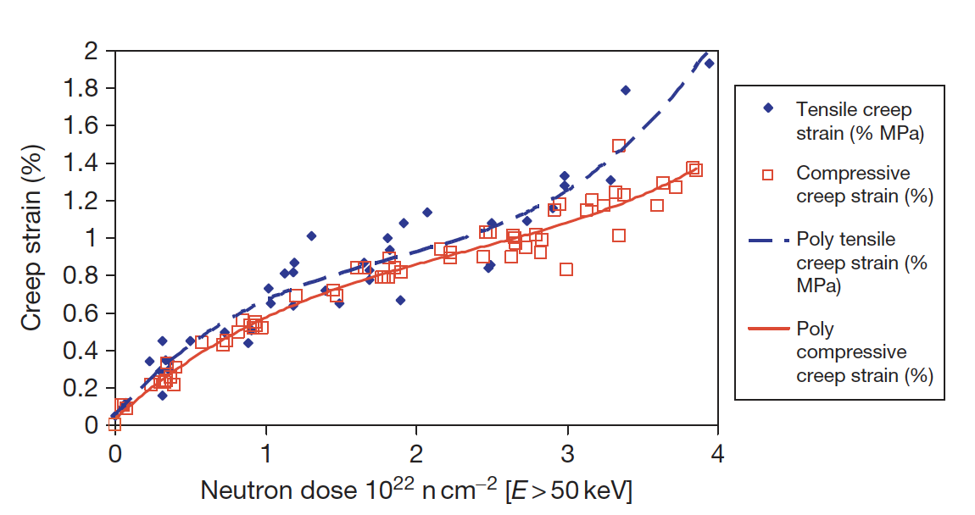
Irradiation Creep
Because of the significance of irradiation-induced creep to the stress levels in graphite core components, accurate models of creep have long been sought, but current models tend to break down at high temperature and fluence
Stress state (compressive/tensile) has an impact on the creep rate
The creep rate increases more rapidly in the tensile loading case compared to the compressive case at high dose

Slide 30
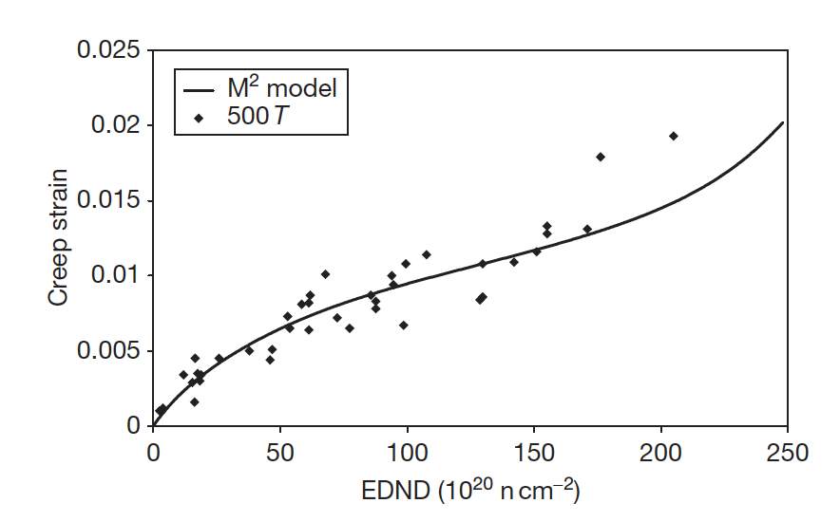
Irradiation Creep Models
Since creep is so important to graphite, a number of creep prediction models have been developed:
Linear viscoelastic creep, UK creep, Kennedy, Kelly and Burchell, etc.
These models can take into account evolving pore structure, thermal expansion, recoverable strain, etc.
The M² model potentially performs the most accurately as a function of dose at relatively low temperatures
However, no model is sufficiently accurate at both high dose and high temperature

Slide 31
Irradiation Creep
Irradiation-induced basal plane dislocation pinning/unpinning in the graphite crystal is the expected mechanism for the irradiation-induced creep
The pinning points are speculated to be interstitial atom clusters
The interstitial clusters are temporary barriers as they are destroyed by further irradiation
The concentration of pinning sites increases under irradiation from the initial value to a steady-state concentration
The initial creep rate is high and decreases to a near steady-state value as the pinning concentration saturates at a level controlled by the neutron flux and temperature
At high dose, the creep rate can again increase because of (1) high internal stress enhancing the creep rate, and (2) the destruction of interstitial pins by thermal diffusion of vacancies

Slide 32
Summary
Graphite has a lot of texture and porosity, dependent upon fabrication
Graphite has anisotropic properties, but nuclear-grade graphite is manufactured in a way to target semi-isotropic properties
Graphite shrinks, then undergoes turnaround
This behavior is governed by point defects, which induced swelling, and close Mrozowski cracks
Turnaround happens quicker at higher temperatures, and is dependent upon applied stress
Irradiation creep is critically important in graphite

Slide 33
EXTRAS….

Slide 34
CTE and Young’s Modulus
The behavior of the CTE and E is complex and differs between anisotropic and semi-isotropic grades
The CTE of Gilsocarbon first increases then reduces
For E there an increase with increasing fluence for Gilsocarbon
If irradiated past turnaround, significant degradation occurs, and the modulus starts to reduce
PGA = Pile Grade A, course, anisotropic graphite
PGA
Gilsocarbon

Slide 35
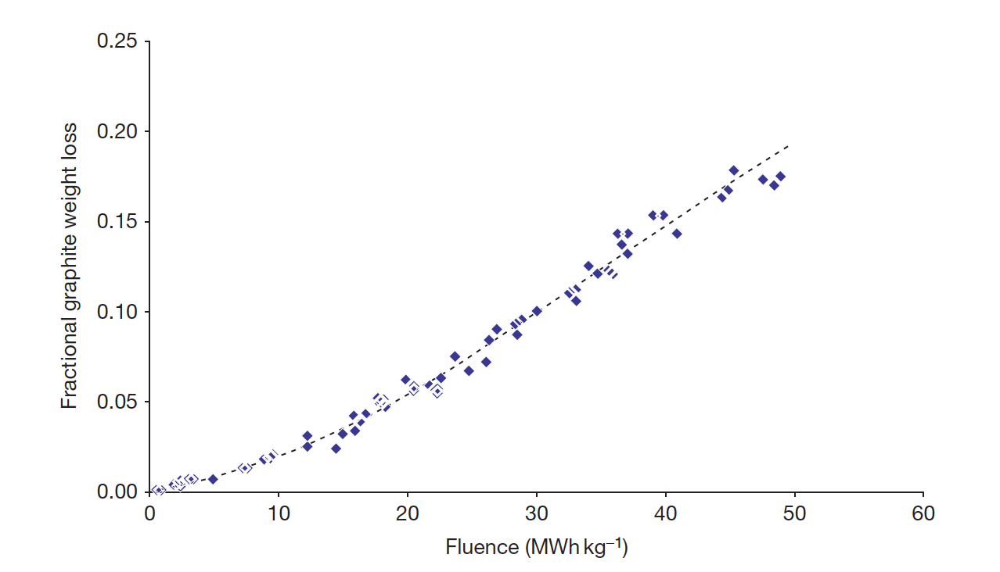
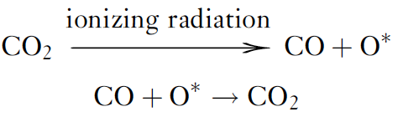
Radiolytic Oxidation
In carbon dioxide (CO2)-cooled reactors, two types of oxidation can occur: thermal and radiolytic
Radiolytic oxidation occurs when CO2 is decomposed by ionizing radiation (radiolysis) to form CO and an active oxidizing species (something like CO3), which attacks the graphite
Radiolytic oxidation occurs predominantly within the graphite open porosity
Can result in weight loss and wastage from graphite

